Slide 1


How to Assess Dynamic Hyperinflation during CPET
COL Aaron B. Holley, MD, FACP, FCCP
Program Director PCCM Fellowship
Associate Professor of Medicine
Walter Reed National Military Medical Center

Slide 2
Conflict of Interest
The view(s) expressed herein are those of the author(s) and do not reflect the official policy or position of Walter Reed National Military Medical Center, the U.S. Army Medical Department, the U.S. Army Office of the Surgeon General, the Department of the Army, the Department of Defense or the U.S. Government.

Slide 3
Learning Objectives
    Understand Dynamic Hyperinflation (DH)
    Review Mechanisms of Dyspnea
    Identify DH on CPET
      FVLs versus VE/MVV
Notes:
Setting the stage – this will be a talk on dynamic hyperinflation during exercise, so on CPET. The physiologic concepts are applicable to places like the ICU, so many of the themes will be familiar. We’ll start by doing a quick review on dyspnea mechanisms – with a focus on mechanical causes.

Slide 4
Dynamic Hyperinflation
In airway disease:
      End-expiratory lung volume (EELV) ↑
      Airways collapse at low lung volumes
      ↑ with obstruction/ventilation
“Air-trapping” with ↑ ventilation
Dolmage et al. Res Med 2013; 107: 953-958
Notes:
So I’ll walk through the definition here: it’s thought that this starts due to the need to keep airways patent at low lung volumes. As ventilation increases, presumably due to some combination of decrease in expiratory time and elevated intra-thoracic pressures causing further collapse DH will worsen. Ultimately it is a significant contributor to exercise termination and intolerable dyspnea.
Many are familiar with this concept in the setting of the ICU – auto-PEEP. You don’t necessarily need obstruction to have auto-PEEP, it just requires high ventilatory rates with lots of positive pressure and decreased expiratory time. The end result – increased inspiratory load (elevated WOB) and ultimately neuro-mechanical uncoupling.

Slide 5
Dynamic Hyperinflation
Ann ATS 2018; 15:1096–1104
Notes:
This is a slide to review things visually – and also to define terms. In particular, comment that EELV is synonymous with FRC at rest, but during exercise we call it EELV.

Slide 6
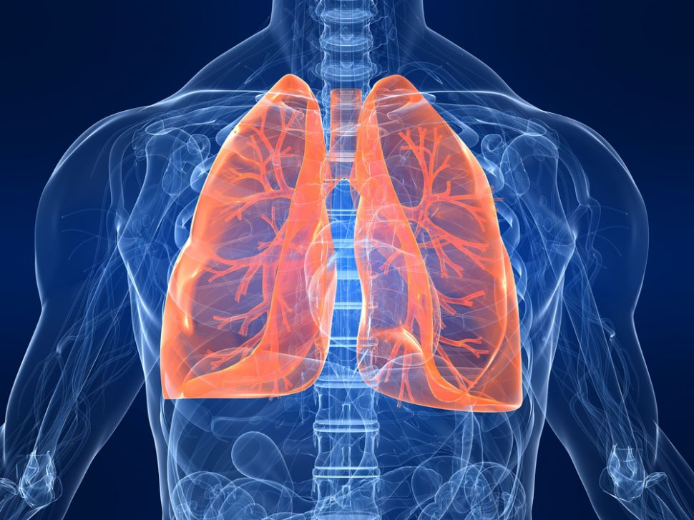
Dynamic Hyperinflation
Consequences
      ↑ Inspiratory work
      Mechanical limitation
      Neuromechanical uncoupling

Slide 7
Dyspnea
Nauserhwan, Lee. Chest 2010;138: 1196-1201
Notes:
There’s cortical processing that occurs as well – as it’s going back and forth in the sensory cortex. Point – it’s not just gas-exchange abnormalities that drive dyspnea. So, your patients doesn’t have to be hypoxic or hypercapneic, to be dyspneic.
Cut down on the dyspnea slides and explanation. Cut down on

Slide 8
Dyspnea
Parshall et al. AJRCCM 2012; 185: 435-452
Notes:
Again – just another one to show how well worked out this is. I serves the point to:
Show how integrated and complex the dyspnea response is
Drive home how difficult it can be to isolate contributors in a given patient
Potentially get rid of this slide

Slide 9
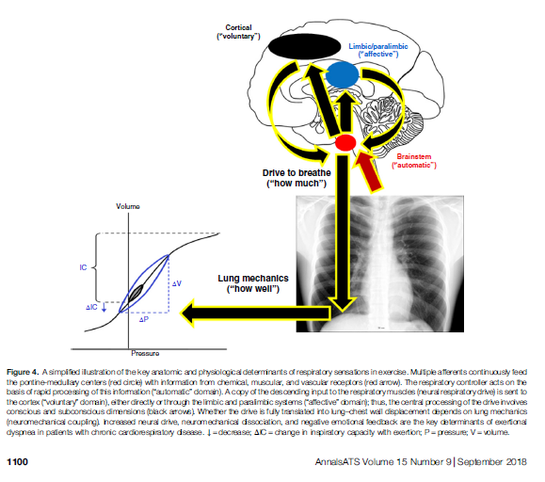
Ann ATS 2018; 15: 1096–1104
Notes:
Make picture bigger, take off the descriptor at the bottom.

Slide 10


Slide 11
Dyspnea in Asthma and COPD
Asthma/COPD
    Chest tightness = bronchoconstriction
    Respiratory effort = neuromechanical coupling (IRV/IC)
    Can’t get a full breath in = (IRV/IC)
  Common complaints
    Activity limitation (most common in uncontrolled asthma)
    Exercise limitation
    Dyspnea
Vermeulen et al. Respiratory Medicine 2016; 117: 122-130
Casaburi, Rennard. AJRCCM 2015; 191:874-876
Notes:
So – these complaints are common in both populations. Remember too, we determine treatment in COPD based on mMRC and CAT, both of which incorporate dyspnea and functional limitations.

Slide 12
DH and Asthma
FEV1 and PEF weakly correlated with activity limitation
↑ aerobic capacity without ∆ spirometry
Resting spirometry is not a good predictor of DH during exercise
Vermeulen et al. Respiratory Medicine 2016; 117: 122-130
Lougheed et al. CHEST 2006; 130:1072–1081
Notes:
Most important point of this slide: activity limitation is common, and resting lung testing doesn’t necessarily predict the presence of DH.
In fairness, all this data is muddy, and the review cited isn’t particularly well written. The review concludes that spirometry is not particularly helpful for predicting exercise limitations. However, they go on to cite plenty of data showing FEV1, IC, FRC, are associated with things like VE/MVV and DH during exercise. So – somewhat contradictory and again, muddy……
Common dyspnea descriptors during exercise in asthmatics: ↑ inspiratory effort (72%), chest tightness (18%), expiratory effort (5%), and air hunger (5%)
The 2nd study, which is from O’Donnell’s lab, shows that DH occurs early on with bronchoconstriction with MCCT (they didn’t exercise their patients). FEV1 and IC dropped almost in tandem, so it’s hard to tease out which change drove symptoms.

Slide 13
DH and Asthma
Lougheed et al. CHEST 2006; 130:1072–1081
Notes:
MCCT testing in subjects:
Conclusions – the authors had a tough time separating DH from bronchoconstriction. Meaning, DH occurs with even minimal bronchoconstriction on MCCT, so as symptoms develop it wasn’t possible to attribute them to one cause or another. The important point is that DH occurs really early on with bronchoconstriction.
This study has interesting mechanistic description of DH – it due to either inspiratory braking vs EFL causes air-trapping. The authors (one of whom is Denis O’Donnell) favor the latter as an explanation.

Slide 14
Dyspnea in Asthma and COPD
Vermeulen et al. Respiratory Medicine 2016; 117: 122-130
Casaburi, Rennard. AJRCCM 2015; 191:874-876
Potter et al. J Clin Invest 1971; 50: 910-919
Notes:
Top graph:
So what you’re seeing here is an inflection point, particularly in those who are IRV-limited (open circles) where TV and IRV max out, and dyspnea increases quickly. Prior to the inflection point, the asthma patients said “my breathing requires more effort.” Afterwards, they said, “I can’t get a deep breath in.” The closed circle group never described being unable to get a deep breath in, even towards the end of the test.
Bottom graph:
O’Donnell threshold proposed for COPD. I get it conceptually and can explain it quite easily. The O’Donnell threshold editorial does a really good job of explaining why VE/MVV is a very poor way to assess ventilatory reserve. Really, there’s no way to get IRV on it, or to assess DH. A person could have massive DH and still have normal respiratory reserve by VE/MVV. The O’Donnell article author argues that FVLs aren’t typically used in clinical exercise labs. We use it – I could take a poll on whether others use it as well.
↓ flow (V), ↑ intra-thoracic pressure (PT)
PT > Pmax (inefficient ventilation)

Slide 15
Mild Asthma and COPD
Ofir et al. AJRCCM 2008; 177: 622–629
Notes:
Another O’Donnell study, mild COPD. They enrolled 21 patients and 21 matched controls with normal lung function.
1st square: Dyspne/VE is skewed upward in COPD patients. So it’s not total ventilation, but rather, ventilation relative to total capacity.
2nd square: What I’m showing here is that they did not desat, but were limited in VO2, VE, and VE/VCO2. The VE/VCO2 does prove that there are gas-exchange abnormalities.
Inspiratory capacity – dropped by as much 41% (1.1L) in the COPD group. On average, it dropped by 0.5L in the COPD group, but changed only 1-9% in the controls. The IRV at max exercise was similar across groups.
IRV, at max exercise, is similar across groups. Lastly, both VE/MVV and IC/TLC explained dyspnea variability, and each explained some of the variable that the other did not. In summary – mechanical measures, normalized for resting lung volumes, explained the largest percentage of dyspnea.

Slide 16
Ann ATS 2018; 15:1096–1104
Notes:
This is a nice visual of where dyspnea started to accelerate in this patient with ILD, COPD, and mitral valve disease. They were considering surgery for the mitral valve, but the CPET helped them determine that her dyspnea was related to her respiratory function, not her cardiac function. The surgery would’ve been worthless, and probably would’ve made her mechanical limitations worse.

Slide 17
Ann ATS 2018; 15:1096–1104
Notes:
I think this will be a good transition slide. I’m going to use this to show specifically what DH looks like. Then I can transition into FVLs.
Although I’m supposed to move this slide forward, I should leave it here too.

Slide 18
VE / MVV
MVV
      Voluntary maneuver
      FEV1 x 35-40
Linearly related to dyspnea
Blunt measure of mechanical limitations
Cannot determine location

Slide 19
CPET FVLs
FRC
EELV
TLC
IRV
ERV
IC

Slide 20
MVV versus FVLs
Johnson et al. Chest 1999;116;488-503
Notes:
So first thing I need to on this slide if define terms. Pretty much everything on this slide needs to be defined.

Slide 21
Hyperinflation and Dyspnea
Johnson et al. Chest 1999;116;488-503
Notes:
I plan on reviewing the concept of the flow-volume loop on this slide. It may take a few minutes and I’ll likely need to go through slowly. Key points:
Review areas or the FVL that reflect IRV, EELV, TV, TLC, and inspiratory and expiratory flow
Show how different the MVV maneuver is, in comparison to the way we breathe during exercise
Use MVV as a dramatic example of what DH “could” look like, and make the point that DH is like an MVV in that your breathing at hight EELVs which is very inefficient
In addition, patients with COPD will breathe above their pmax, which is also very inefficient and likely due in part (and probably in large part) due to DH
Make sure you explain the FVLs and and how Carefusion and Viasys does it, how the text does it.

Slide 22
CPET FVLs
Notes:
A few notes on the Carefusion (Vmax) loops:
They use a mass-flow sensor to assess flow, which is particularly sensitive to temperature and humidity changes leading to ‘drift’
They’re no software – centurysuite – uses something called DVT, a digital flow sensor, that is less susceptible to drift. The software is also better so it provides a cleaner, more accurate loop.
It’s not clear that the IC needs to start right at EELV. In theory, I don’t believe it should matter.
This is the slides I should probably use to discuss the IC maneuver – pros/cons, pitfalls

Slide 23
MedGraphics

Slide 24
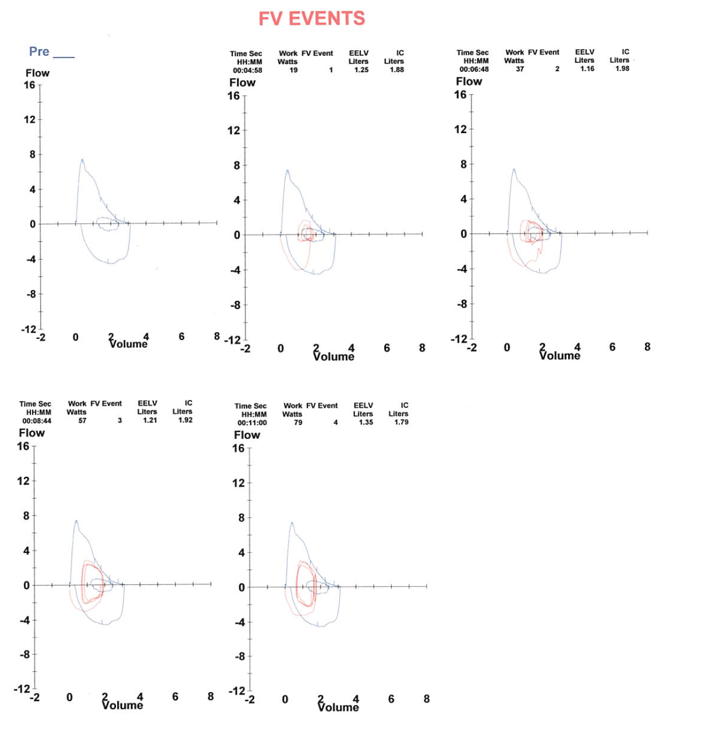
CPET FVLs - DH
Notes:
I don’t think we need arrows here. I think I can just highlight with the cursor and explain the slide.

Slide 25
CPET FVLs
Johnson et al. Chest 1999;116;488-503

Slide 26
CPET FVLs
↑ EELV not specific for DH
    CHF, hyperventilation, obesity
    High requirement/capacity
  IC/VE slope
    Improved accuracy
Notes:
I would question the utility of IC/VE slope.

Slide 27
Learning Objectives
    Understand Dynamic Hyperinflation (DH)
    Review Mechanisms of Dyspnea
    Identify DH on CPET
      FVLs versus VE/MVV
Notes:
Setting the stage – this will be a talk on dynamic hyperinflation during exercise, so on CPET. The physiologic concepts are applicable to places like the ICU, so many of the themes will be familiar. We’ll start by doing a quick review on dyspnea mechanisms – with a focus on mechanical causes.

Slide 28

Notes:
Really write out your “take-home” points

Slide 29
Questions?
Notes:
Move slide 18 to the beginning

