Slide 1

HOW TO PREPARE YOUR PRESENTATION SLIDES FOR
SYNC

Slide 2
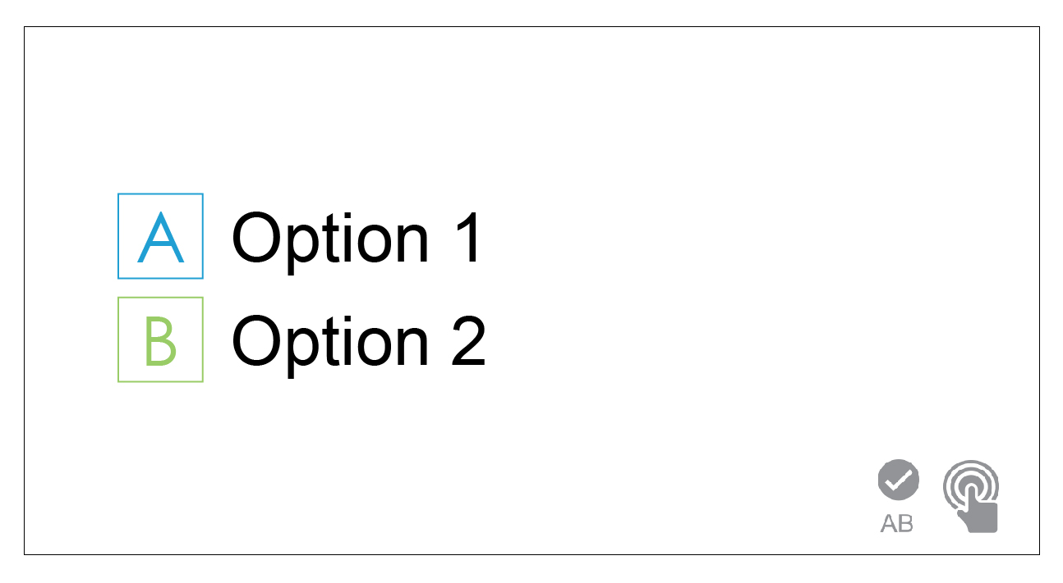
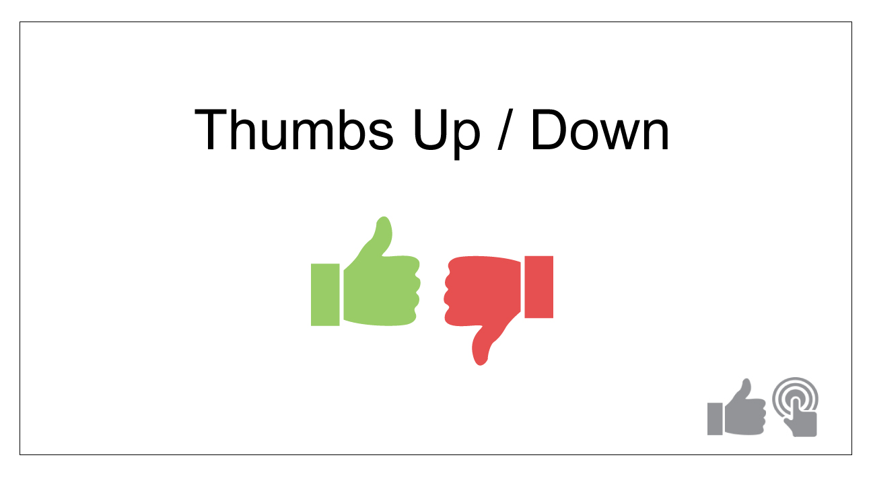
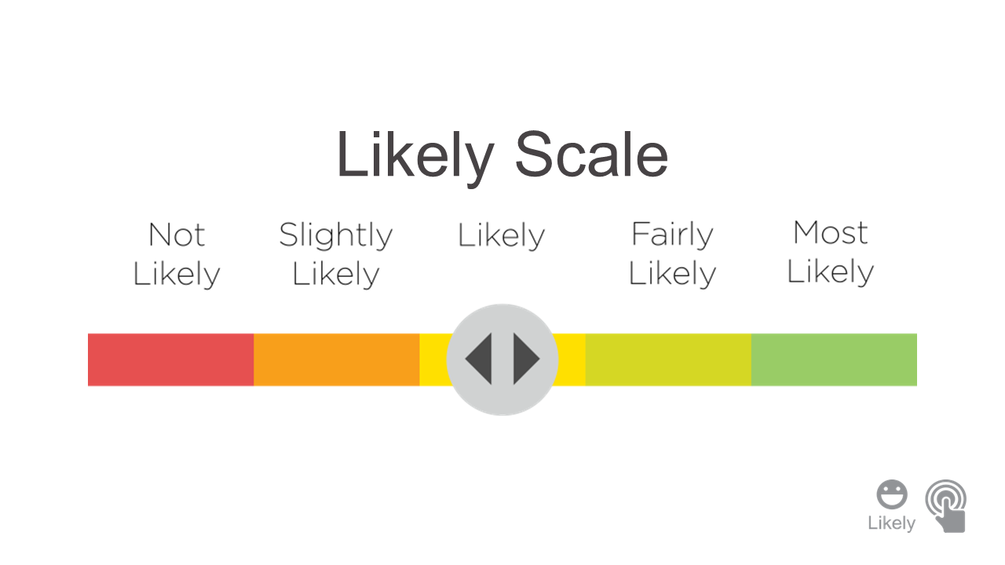
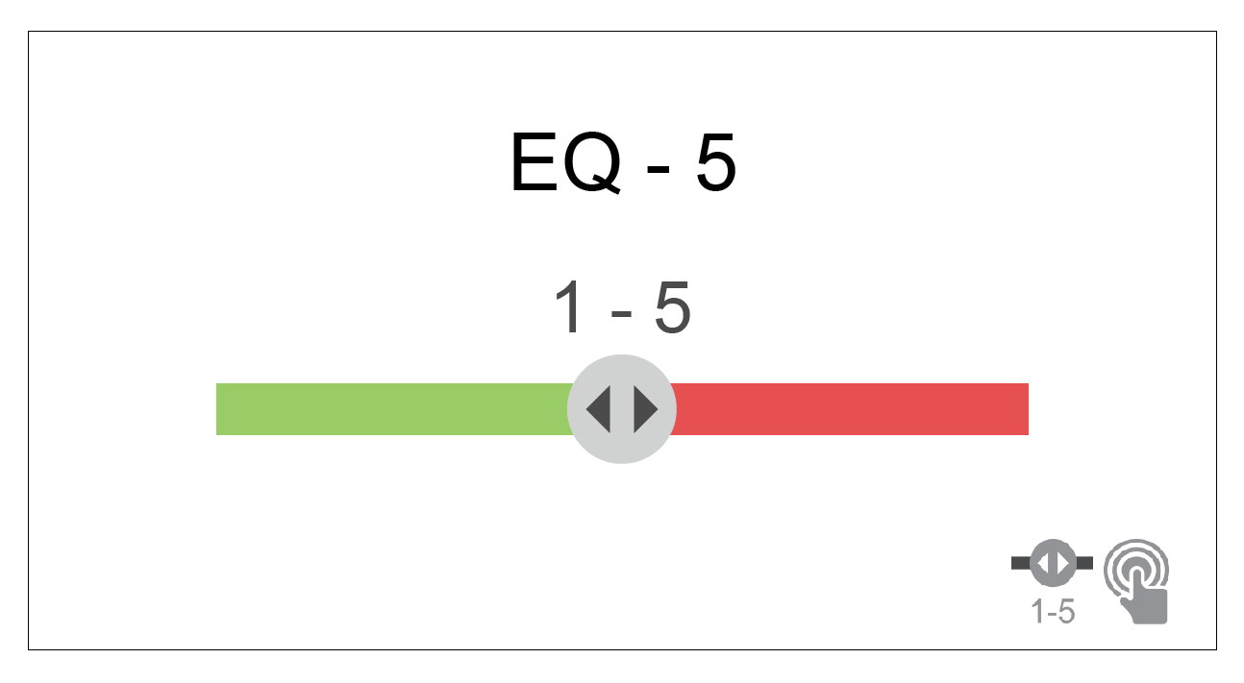
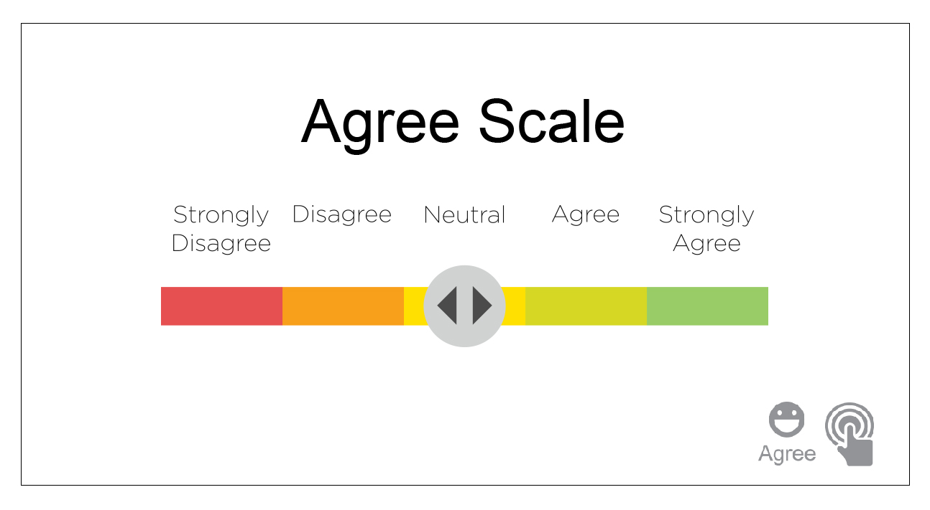
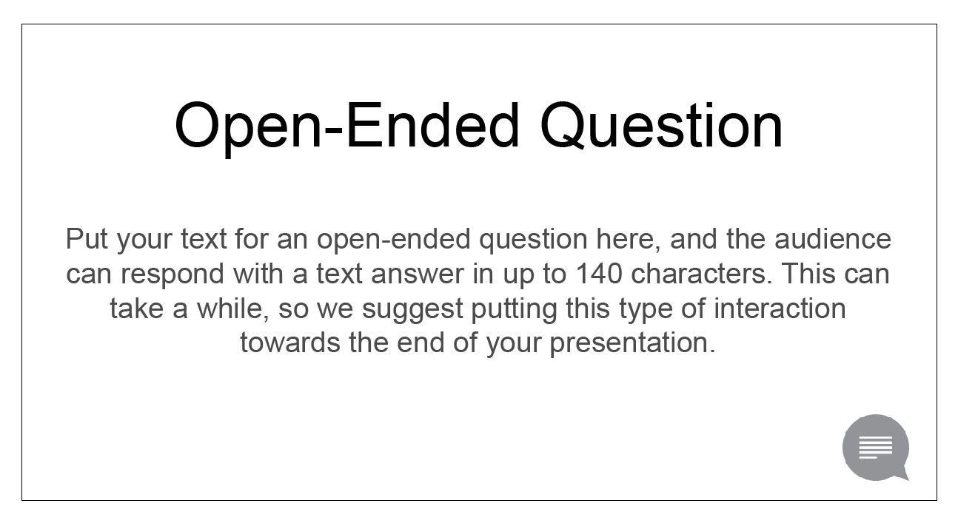
Options for Interaction Slides
Use this slide for multiple choice questions with 2-5 options (see similar slides for ABC, ABCD, ABCDE, 12, 123, 1234, or 12345).
Use this slide for questions with “Yes/No” answers or “Agree/Disagree” answers.
Use this slide to enable the audience to vote on a scale or answer with a percentage (see similar slides for EQ – 10 and EQ – 100).
Use this slide for questions like “How likely are you to…?”
Put your text for an open-ended question here, and the audience can respond with a text answer in up to 140 characters.
Use this slide to ask the audience how much they agree or disagree with a statement.

Slide 3
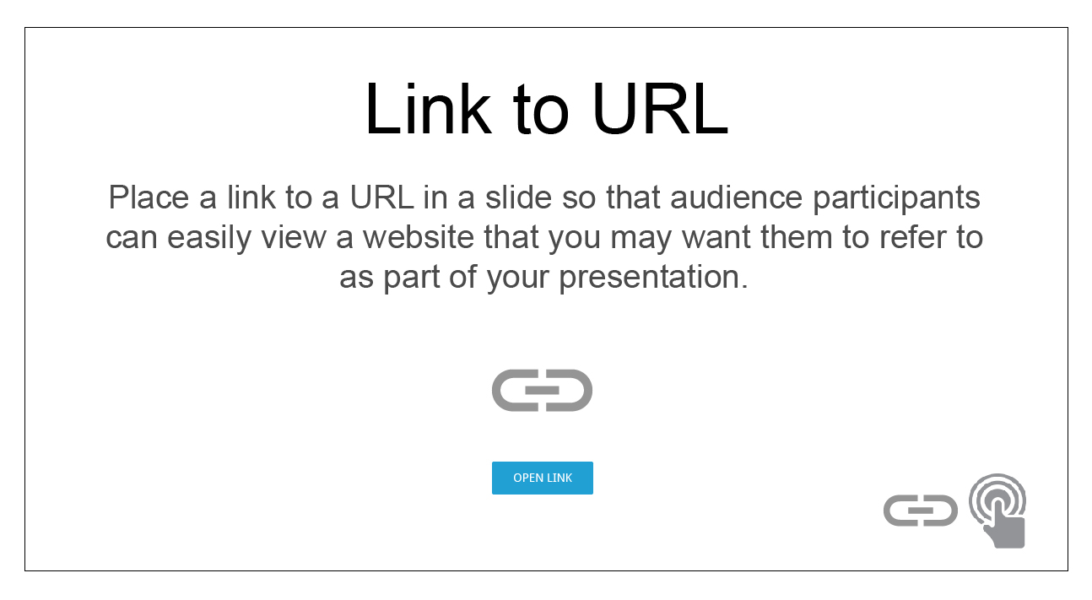
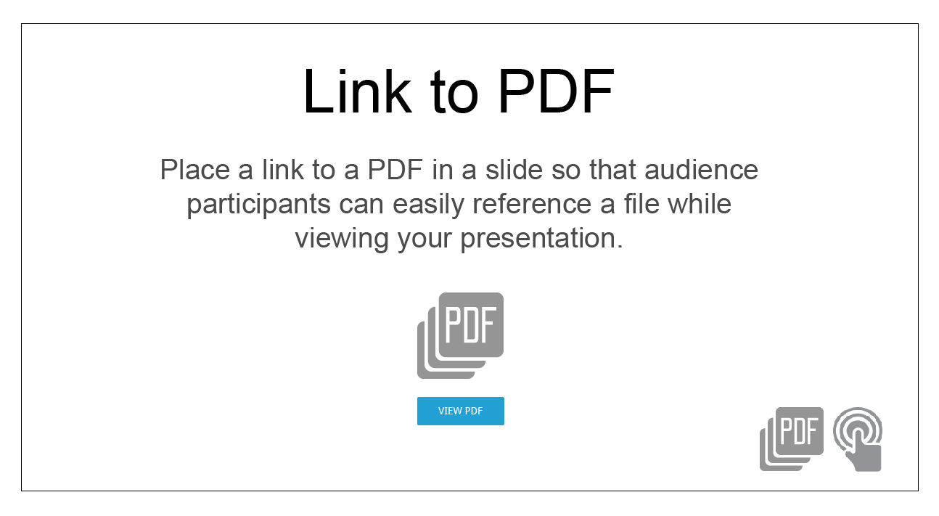
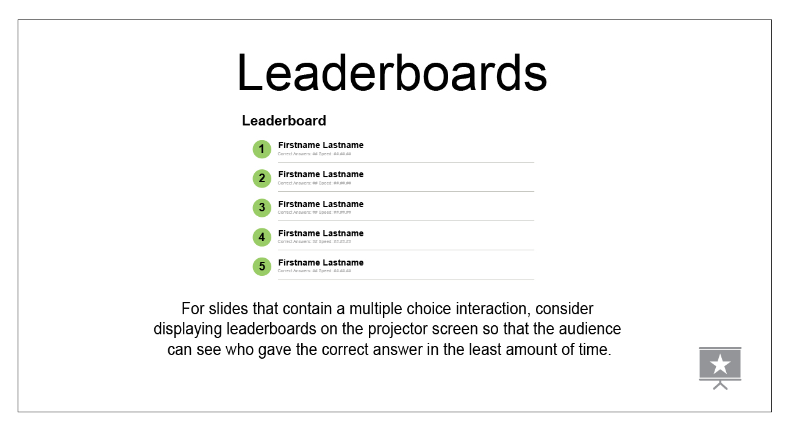
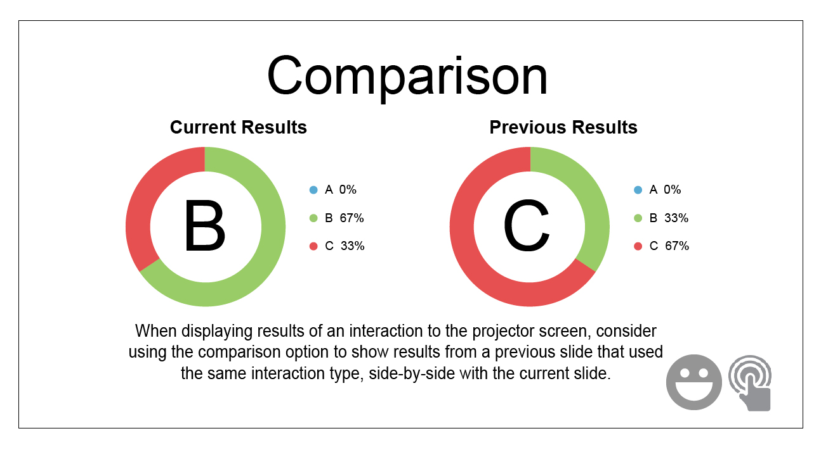
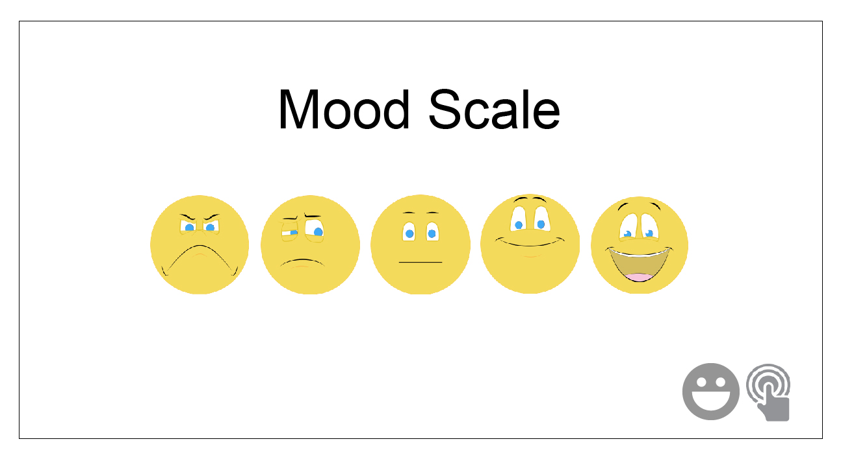
New Options for Interaction Slides
Use this slide to include a link to a URL as part of your presentation. Clicking the button opens the URL in a new browser window.
Use this slide to include a link to a PDF as part of your presentation. Clicking the button opens the PDF in a new browser window.
Display leaderboards on the projector screen to show which participants answered correctly in the least amount of time.
Display results from a previous slide side-by-side with the current slide on the projector screen to compare data.
Use this slide to ask the audience to select how they feel about the slide content.

Slide 4


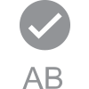

EXAMPLE SLIDE
How do you feel about multiple choice questions?
I love them!
I hate them!

Slide 5


EXAMPLE SLIDE
What are you most interested in hearing more about?
Politics
Space X
The New iPhone

Slide 6


EXAMPLE SLIDE
Favorite morning beverage?
Red Bull Energy!
Coffee
Tea
Juice

Slide 7


EXAMPLE SLIDE
What is the capital of Idaho?
Eagle
Des Moines
Boise
Tallahassee
Potatoville

Slide 8
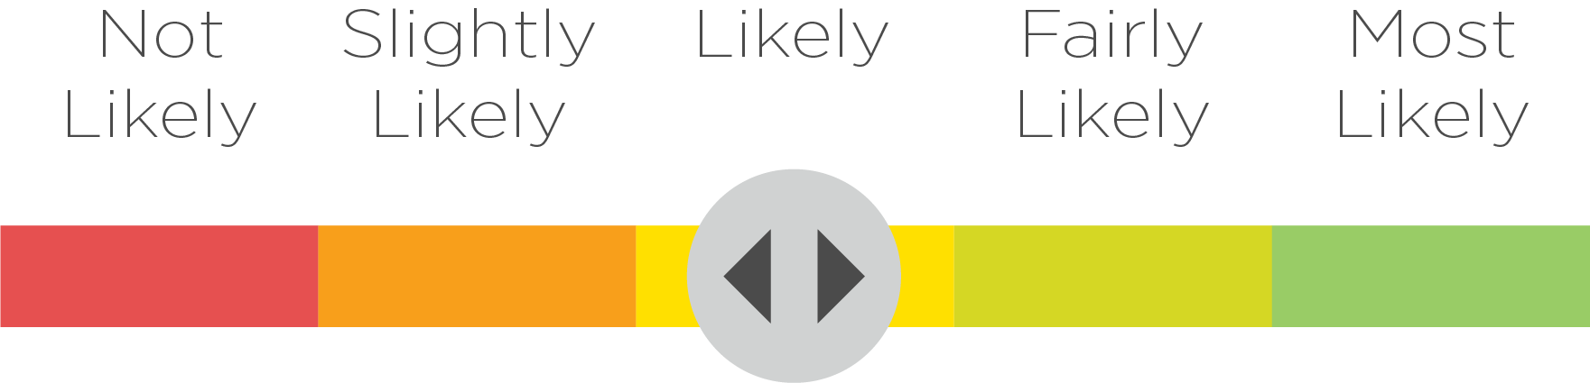

Likely Scale
Remove the icon above when building your slides. The presentation platform will automatically input the icon beneath your slide. See next slide for an example.

Slide 9
Example Slide
How likely are you to fall asleep during this presentation?

Slide 10
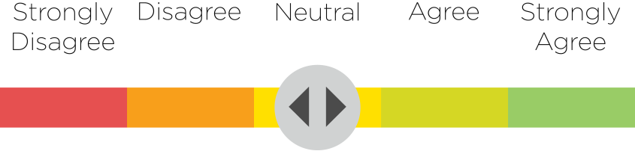

Agree Scale
Remove the icon above when building your slides.
The presentation platform will automatically input the icon beneath your slide. See next slide for an example.

Slide 11
Example Slide
Audience interaction improves attention span.

Slide 12
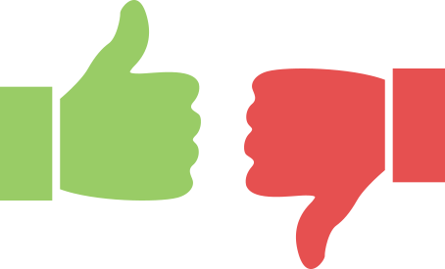

Thumbs Up / Down
Remove the icon above when building your slides. The presentation platform will automatically input the icon beneath your slide. See next slide for an example.

Slide 13
Example Slide
Are you still awake?

Slide 14
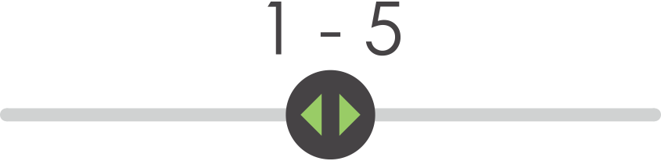

EQ - 5
Remove the icon above when building your slides. The presentation platform will automatically input the icon beneath your slide. See next slide for an example.

Slide 15
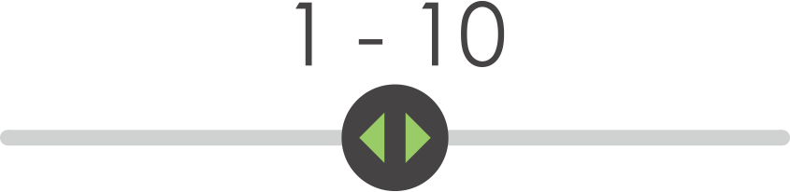

EQ - 10
Remove the icon above when building your slides. The presentation platform will automatically input the icon beneath your slide.

Slide 16
Example Slide
On a scale of 1-10, how would you rate this presentation?

Slide 17
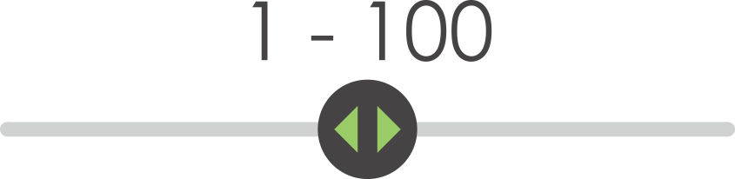

EQ - 100
Remove the icon above when building your slides. The presentation platform will automatically input the icon beneath your slide.

Slide 18


LINK TO PDF
Place a link to a PDF in a slide so that audience participants can easily reference or download a file while viewing your presentation.

Slide 19


LINK TO URL
Place a link to a URL in a slide so that audience participants
can easily view a website that you may want them to refer to
as part of your presentation.

Slide 20


Having a good day so far?
Remove the icon above when building your slides.
The presentation platform will automatically input the icon beneath your slide.

Slide 21

OPEN-ENDED QUESTION SAMPLE
What did you think of the presentation?
Put your text for an open-ended question here, and the audience can respond with a text answer in up to 140 characters. This can take a while, so we suggest putting this type of interaction towards the end of your presentation.

Slide 22
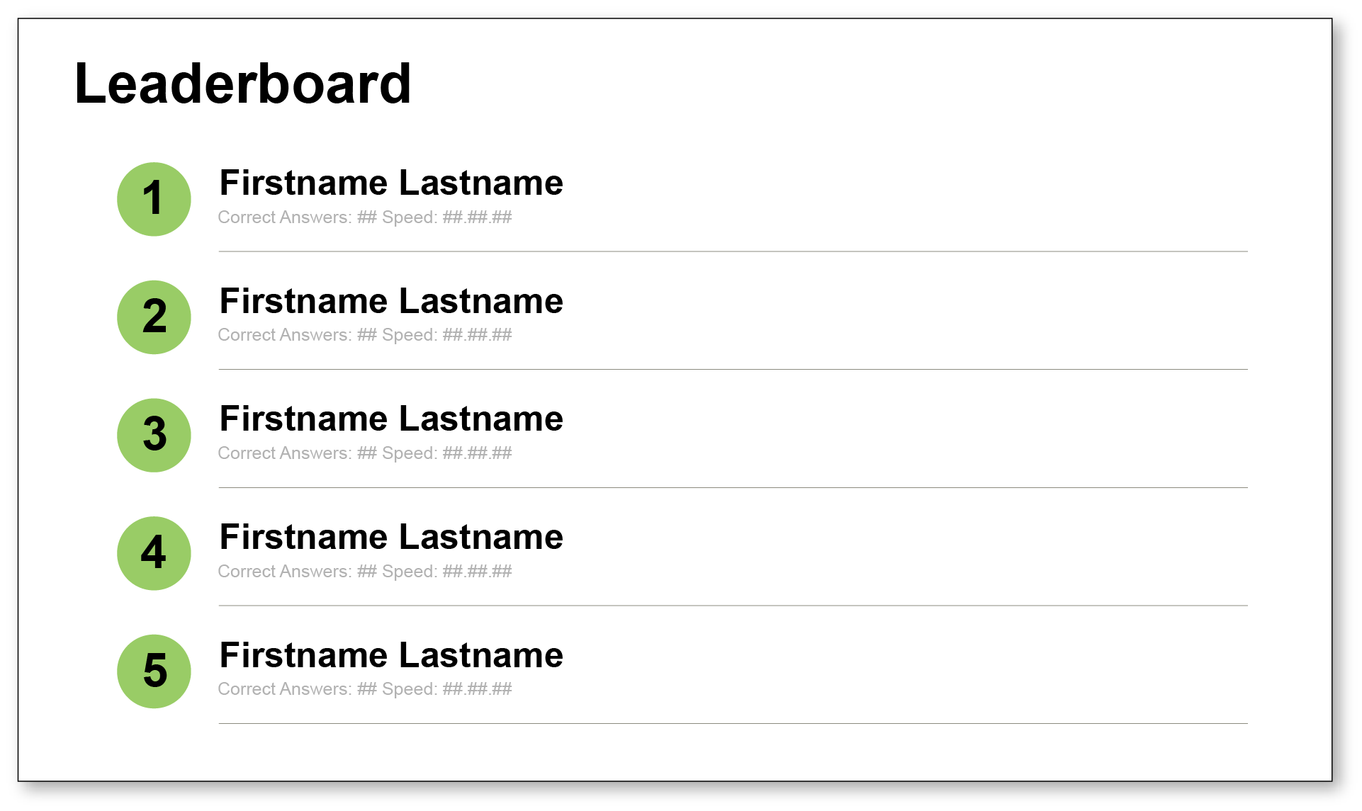

Leaderboards
For slides that contain a multiple choice interaction, consider displaying leaderboards on the projector screen so that the audience can see who gave the correct answer in the least amount of time.

Slide 23
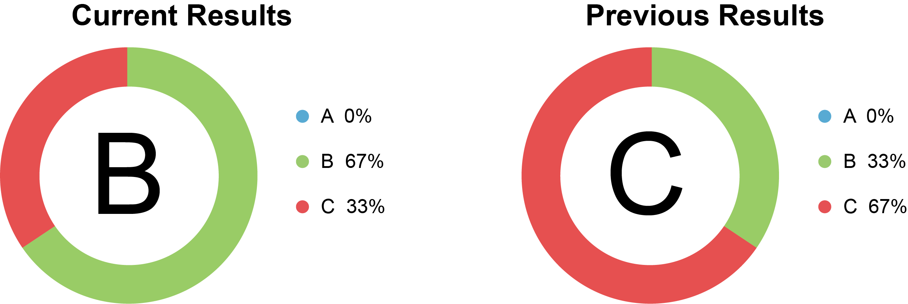
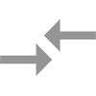
Comparison
When displaying results of an interaction to the projector screen, consider using the comparison option to show results from a previous slide that used the same interaction type, side-by-side with the current slide.

Slide 24



Slide 25


Slide 26
HOW TO FORMAT YOUR SLIDES FOR
SYNC:
For those slides that you want to feature an interaction (an opportunity for the audience to participate by responding to a poll, answering a question, submitting a text response /question/comment, etc), simply use the template slides below. Copy the slide and paste into your slideshow. We’ve provided each option for an interaction slide in multicolor, white background and gray background themes. Choose which theme will go best with your presentation.
Delete provided text and insert your own text (i.e. questions, answers, “How likely are you…” etc.).
Once you’ve built your slideshow, delete this slide and any other template slides you will not be using.

Slide 27

Best Practices for using SYNC
THINGS TO CONSIDER: Typically, 70% of user responses are in the first 15 seconds of voting
Consider your purpose
      What do you want out of the presentation?
      What are your learning objectives?
      Assess comprehension?
      Apply new concepts?
      Check in?
    Questions should be meaningful and purposeful
    Questions should serve both you (speaker) and attendee
Consider what information you want from the audience
      Pre-session info?
      Post-session info?
      Feedback?

Slide 28
HELPFUL HINTS:
What we’ve learned from previous presentations using SYNC
The interaction with the highest response is “Thumbs Up/ Down”, followed by multiple choice options.
The interaction with the lowest response is the “Text Response”. We believe this is because it takes people more time and effort to type in their text responses.
Including an interaction every 5-7 slides maintains engagement throughout the presentation.
Including humor into a trivia or polling question increases early participation and onboarding.
Use a simple interaction early (and show the results) to get audiences logged in right away. Attendees tell us that it helps them understand that this presentation will be different and that they will have a voice.

